Slide 2
Campaign Name
Epsilon Epsilon Chapter
established 1920

Slide 3
Situation: Current House
First house: 502 Duck Street
Second house: 302 Knoblock
Current house: Built in 1929
Original Cost: $60,000 plus $10,000 for furniture
Despite its charm and treasured memories, EE Chapter house condition is inferior to most
living options at Oklahoma State University
– both Greek and non-Greek

Slide 4
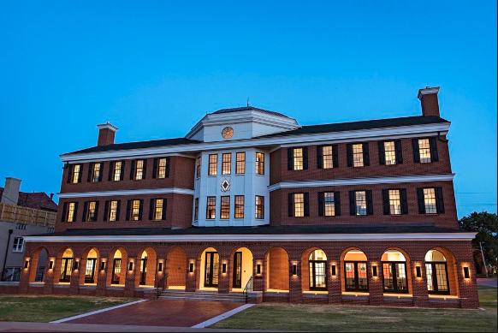
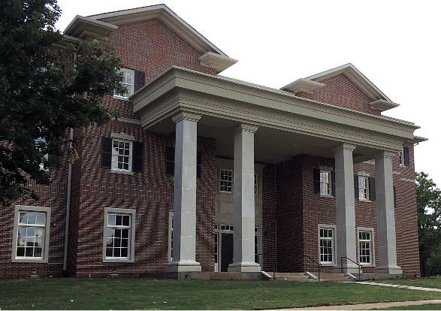
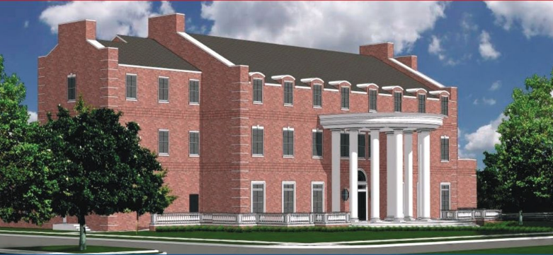
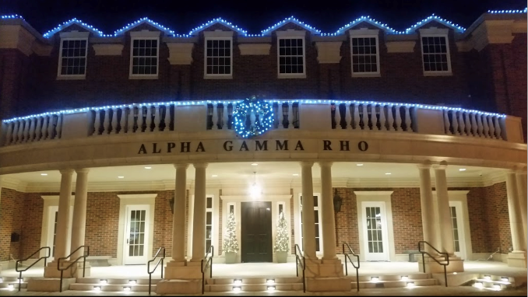
Situation: Competition
Pike
Fiji
Beta
AGR

Slide 5
Situation: Competition
For each year we remain in the current facility, Sigma Nu’s lose competitive ground in attracting young men who excel in academics, leadership, athletics, and campus activities at OSU

Slide 6
Vision
A new state-of-the-art facility will give the Chapter a tremendous, tangible, and immediate boost in RECRUITMENT

Slide 7
Vision
Our new and larger fraternity house will be a visual representation of our Chapter and provide increased space, amenities, and offerings essential to today’s COLLEGIATE LIFESTYLE

Slide 8
Commitment to Leadership
Epsilon Epsilon has been awarded Rock Chapter 12 times with the second place chapter awarded only 9 times
2018 | 2004 | 1984
2014 | 2002 | 1982
2012 | 1990
2010 | 1988
2006 | 1986

Slide 9
Commitment to Leadership
Epsilon Epsilon Alpha Affiliates totals 43 with the second place chapter only at 22!
Year | Recent Alpha Affiliates
2016 | Connor Mojo
2017 | Casey Kolbeck
2018 | Gage Calhoon
2018 | Alex Kirkpatrick

Slide 10
Commitment to Leadership
Epsilon Epsilon recent graduates have been awarded THE National Scholar of the Year 8 times from 2001 through 2018
Our scholars have won the award an amazing 44% of the time

Slide 11
Commitment to Leadership
Temple Classic Philanthropy
2016: $21,000 raised to benefit the Jacquelyn House of ARC Group Homes
2017: $30,000 raised to benefit Folds of Honor
2018: $33,000 raised to benefit the Trimble Strong Foundation
2019: $31,000 raised to benefit Cleats for Kids

Slide 12
Commitment to Leadership
EE Chapter has adopted and is executing Sigma Nu's award-winning ethical leadership development program

Slide 13
Commitment to Leadership
As quoted from the Executive Director of the National Sigma Nu Fraternity
“The Epsilon Epsilon Chapter sets the standard…”
Quotes from Burns Hargis, President of Oklahoma State University
“…fully endorse this project as a key element in the continuity of the success of our fraternity.”
“I applaud the launching of this capital campaign for the Chapter House of which I will be a part.”

Slide 14
Commitment to Leadership
Alumni Involvement
Alumni Advisory Board – 8 members
Wes Holmes - 1999 Steve Brown – 1965 Bob O’Neal – 2007
Mark Mitchell – 1988 Taylor Gilpin – 2003 Kelly Miller – 1984
Luke Martin – 1999 Jeff Burro – 2005
House Corporation – 9 members
Stan Bugh – 1980 John Bartley – 1989 Marcus Lemon – 1977
Mark Lambert – 1981 Greg Tontz – 1986 Patrick Altendorf – 2007
Neil Gilpin – 1977 Bob O’Neal – 2007 Wes Holmes – 1999
National Leadership – 3 Past Regents
James Bradley Joe Francis Charlie Eitel

Slide 15
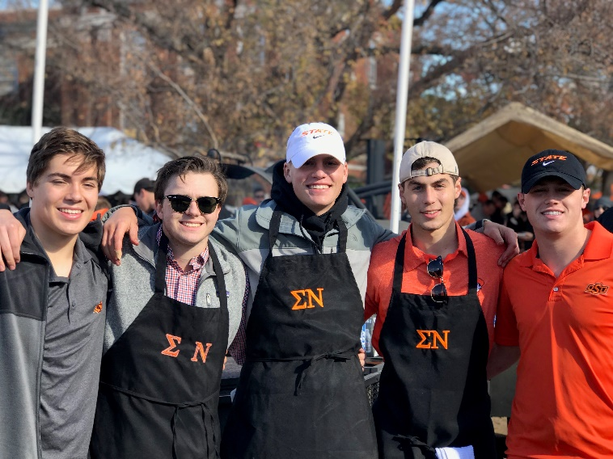
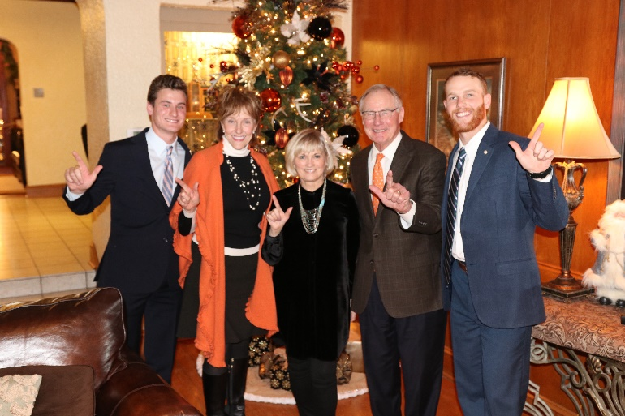
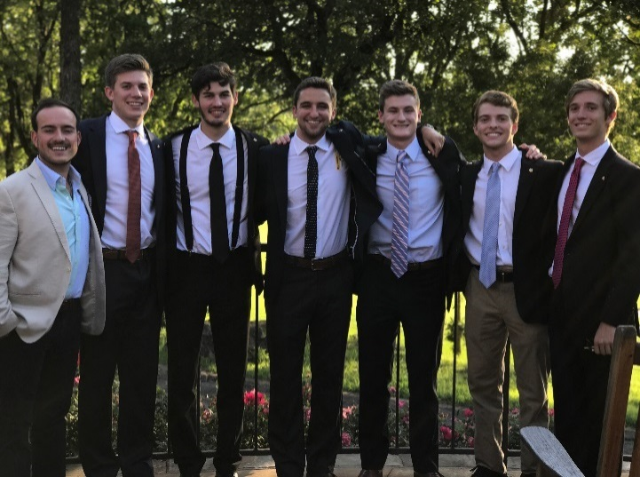
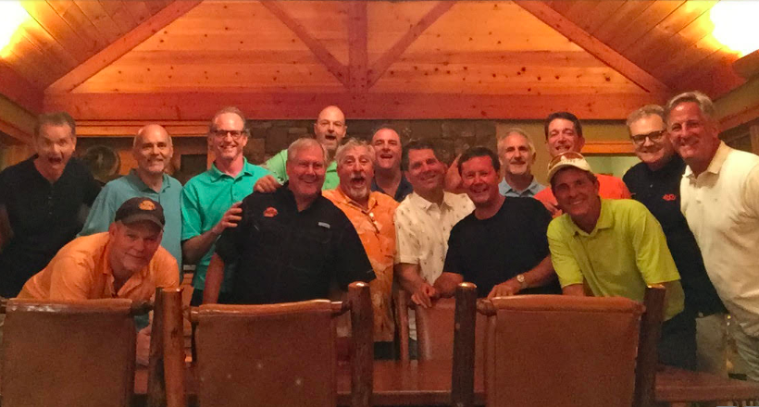
Commitment to Leadership
Alumni Involvement

Slide 16
Background
Facility History
Current House:
Construction began in 1928
Completed in 1929
Cost: $60,000 plus $10,000 for furniture
Original capacity: 38 men
Two Major Fires:
December 29, 1957
January 8, 1968

Slide 17
The New Facility
State-of-the-art facility with strategic, functional spaces
Tudor style architecture
Iconic red brick with white stone accents
30,000 ft., 3 floors and a full basement
Capacity: 96 men (Current 82)
Study Areas on all Floors
Storm Shelter
Multi-use areas for study, show practice and Homecoming
Multi-level Parking Garage
Project Cost: $12M

Slide 18
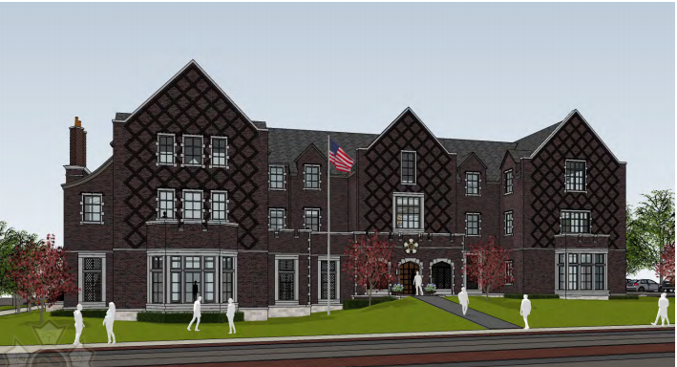
Creating a legacy
Insert rendering
North Perspective View

Slide 19
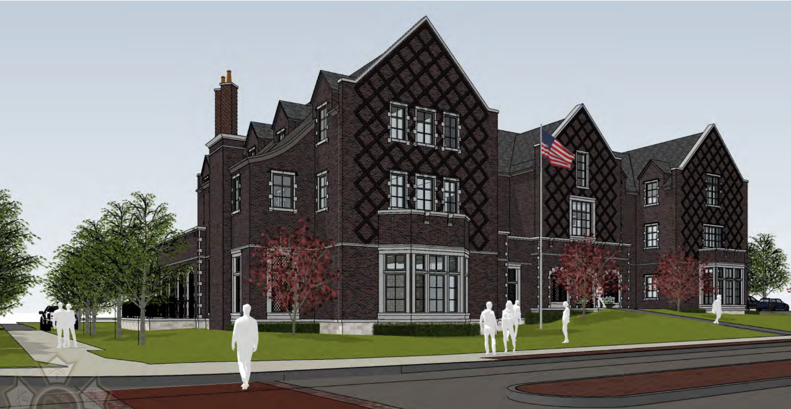
Creating a legacy
Insert rendering
Northeast Eye Level Perspective

Slide 20
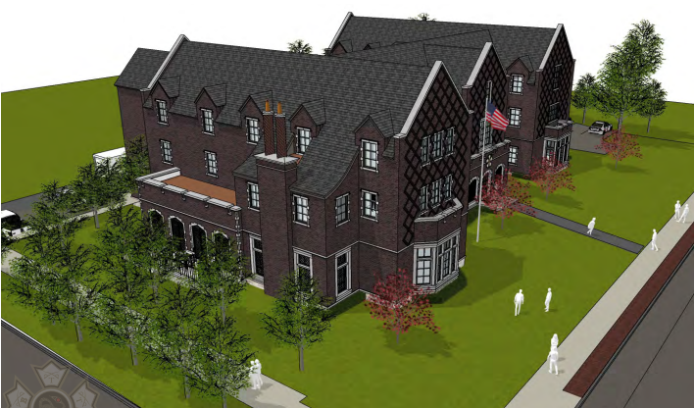
Creating a legacy
Insert rendering
Northeast Ariel View

Slide 21
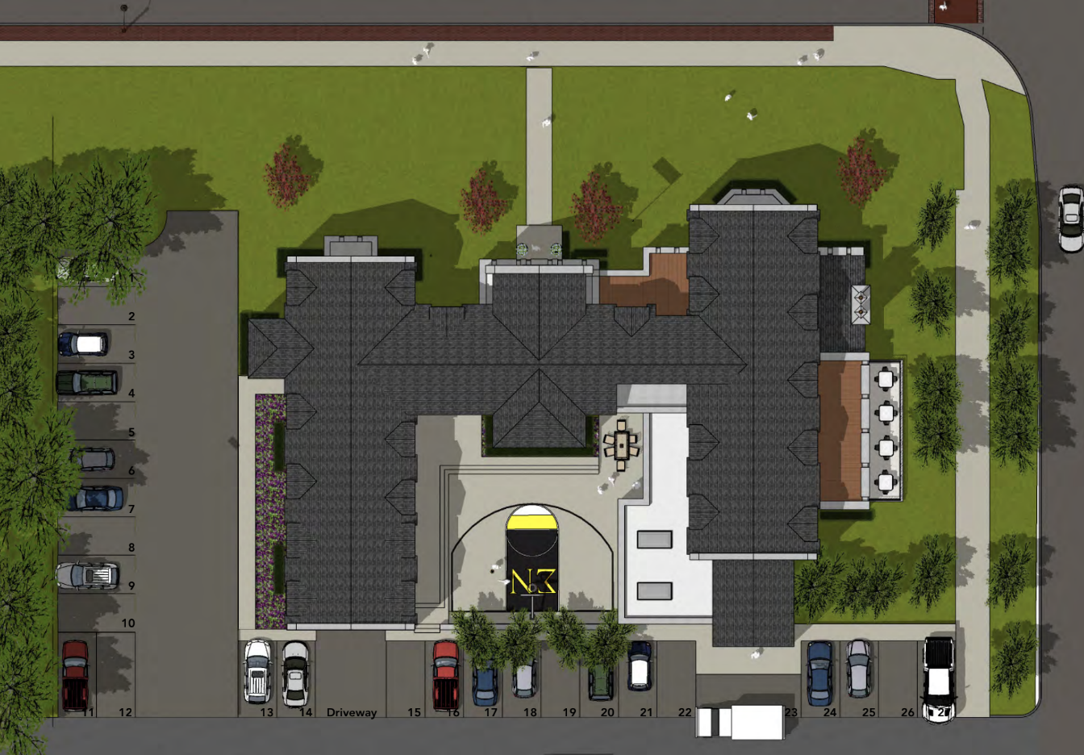
One united vision
Site Plan

Slide 22
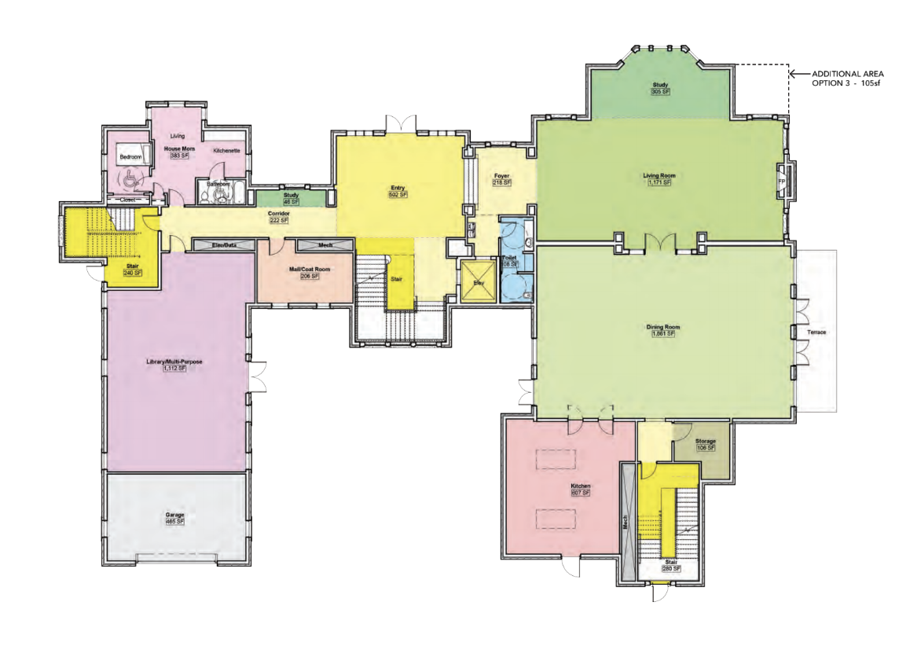
One united vision
First Floor
9,300 GSF

Slide 23
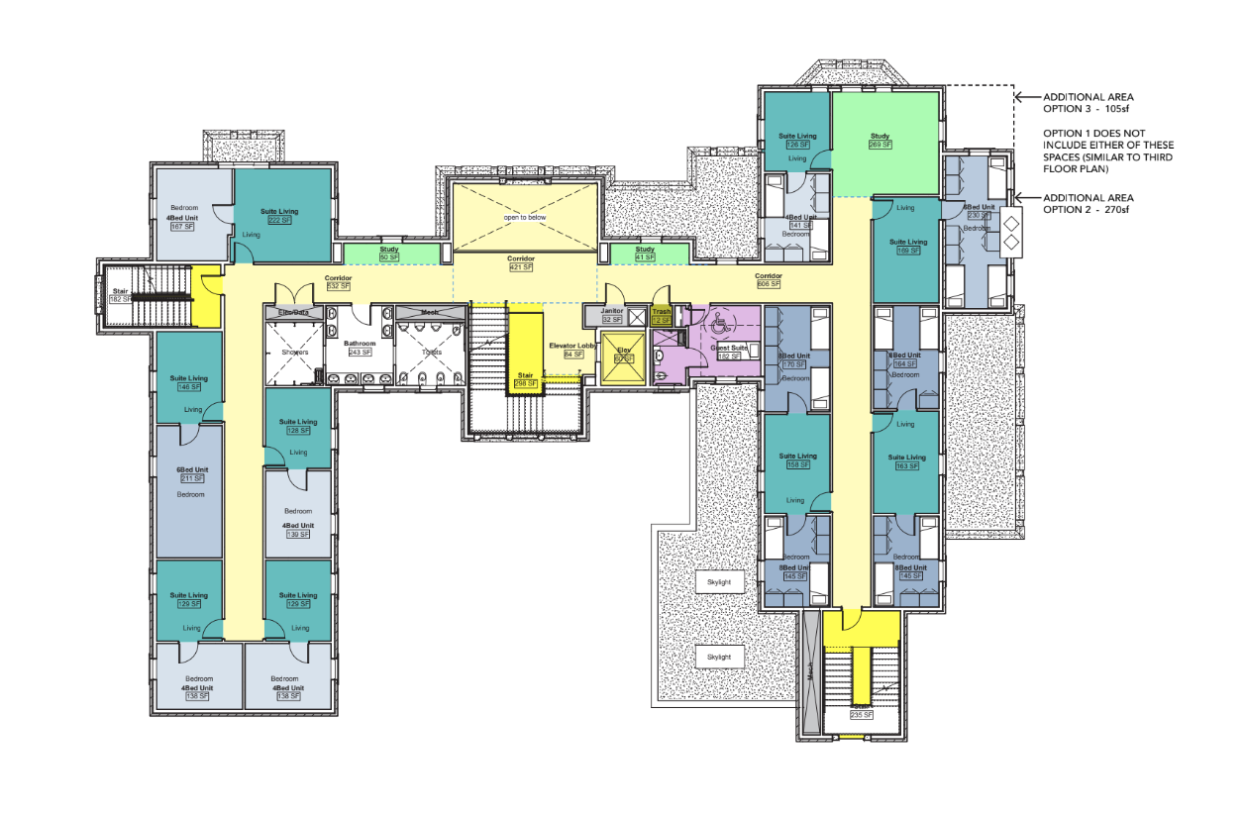
One united vision
Second Floor
48 Beds
6,670 GSF

Slide 24
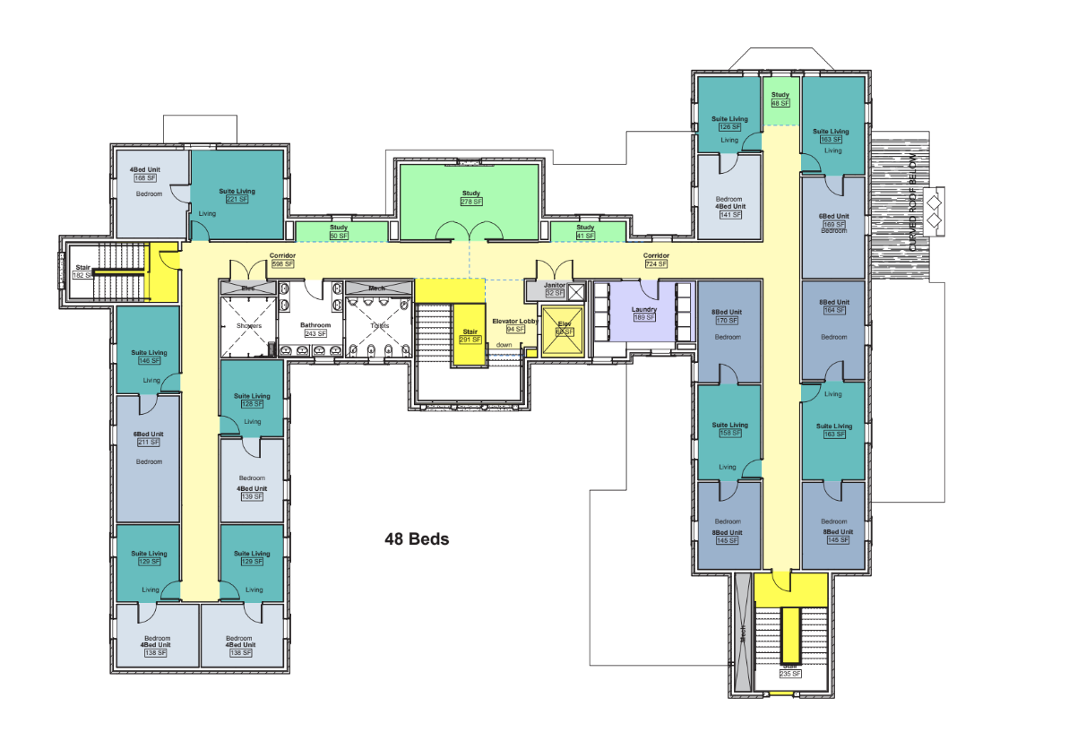
One united vision
Third Floor
48 Beds
6,950 GSF

Slide 25
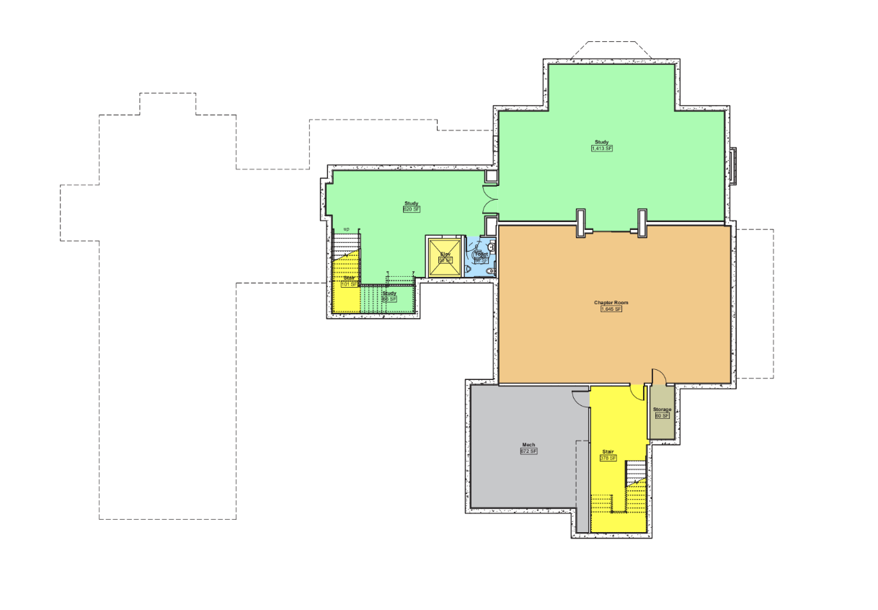
One united vision
Basement
5,735 GSF

Slide 26
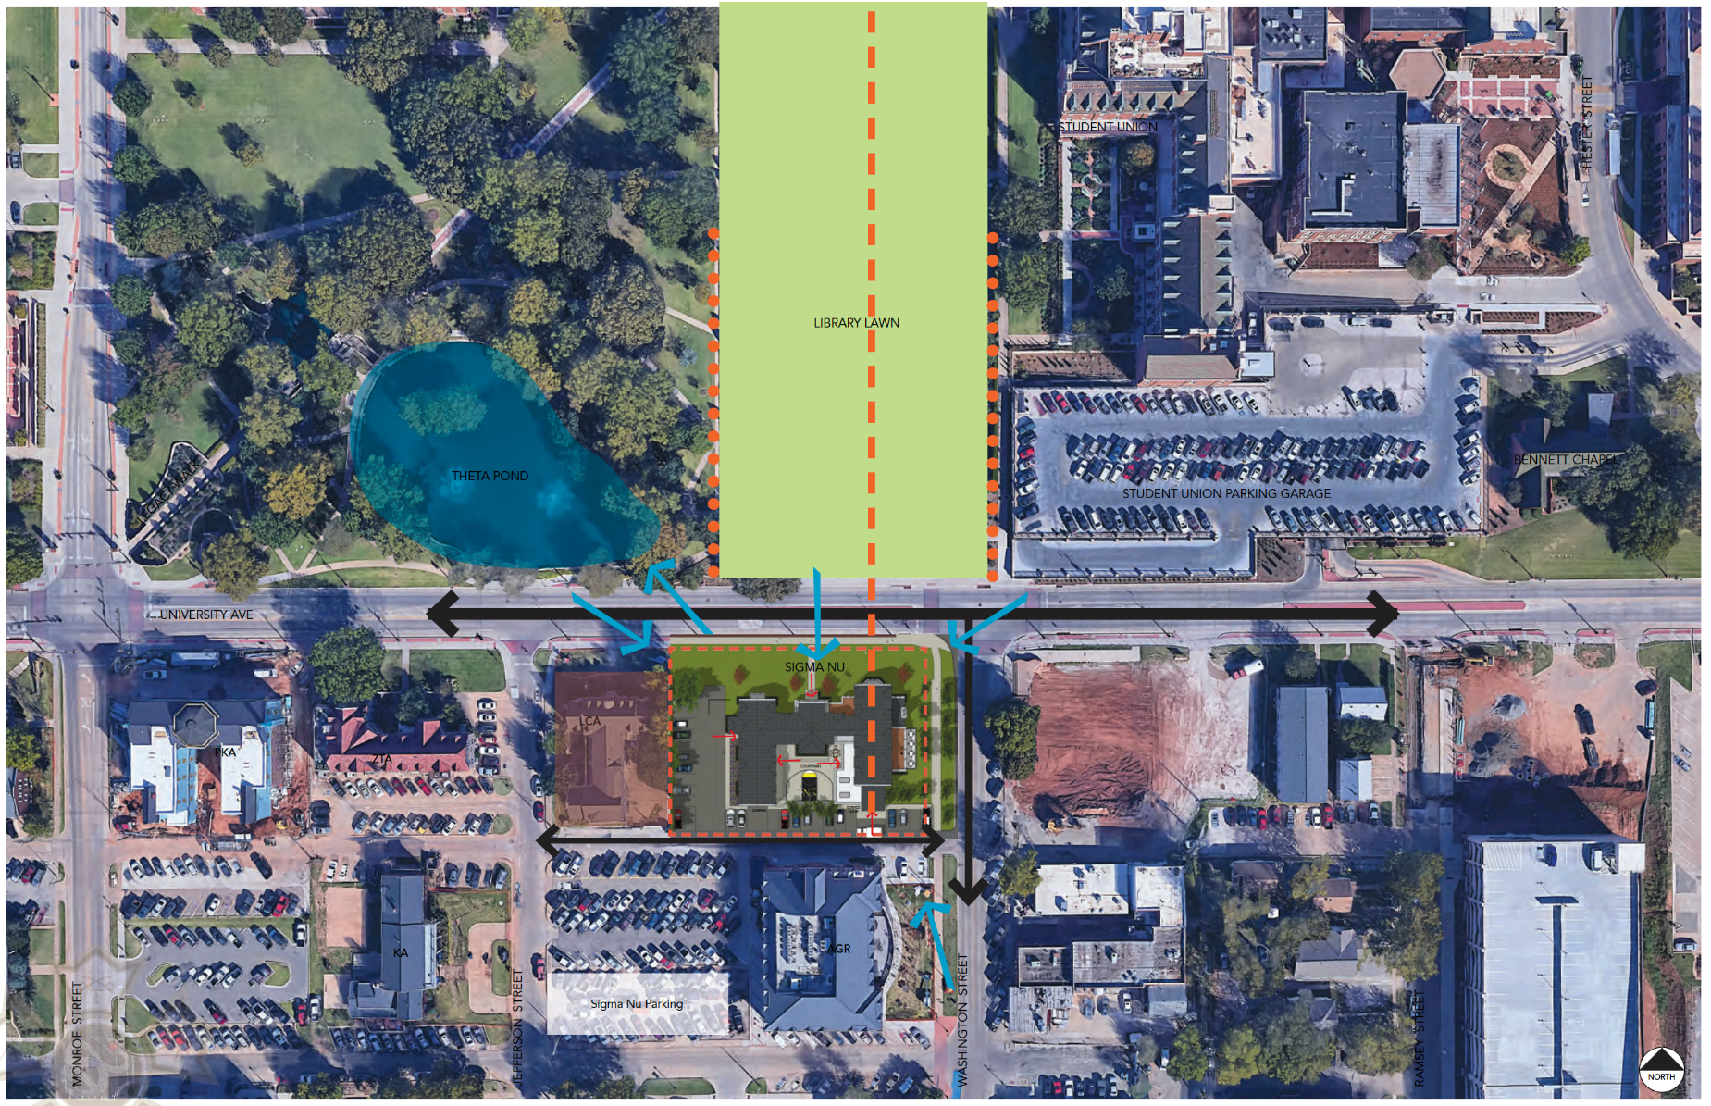
One united vision
Campus Relationship

Slide 27
Commitment to Legacy
So…where are
we now?

Slide 28
Help extend the Legacy
Campaign Funds Raised to Date:
$2.8 million

Slide 29
Help extend the Legacy
Building a 96-person state-of-the-art facility with THE
BEST living arrangements, services, and amenities
offered at Oklahoma State University is costly.
And we seek to build the new facility without bonds,
long-term capital debt, or financial reliance from
national headquarters.

Slide 30
Help extend the Legacy
Philanthropic donations are being accepted to fund this mission-critical project
YOUR PARTICIPATION IS KEY IN
ACHIEVING CAMPAIGN GOAL!

Slide 31
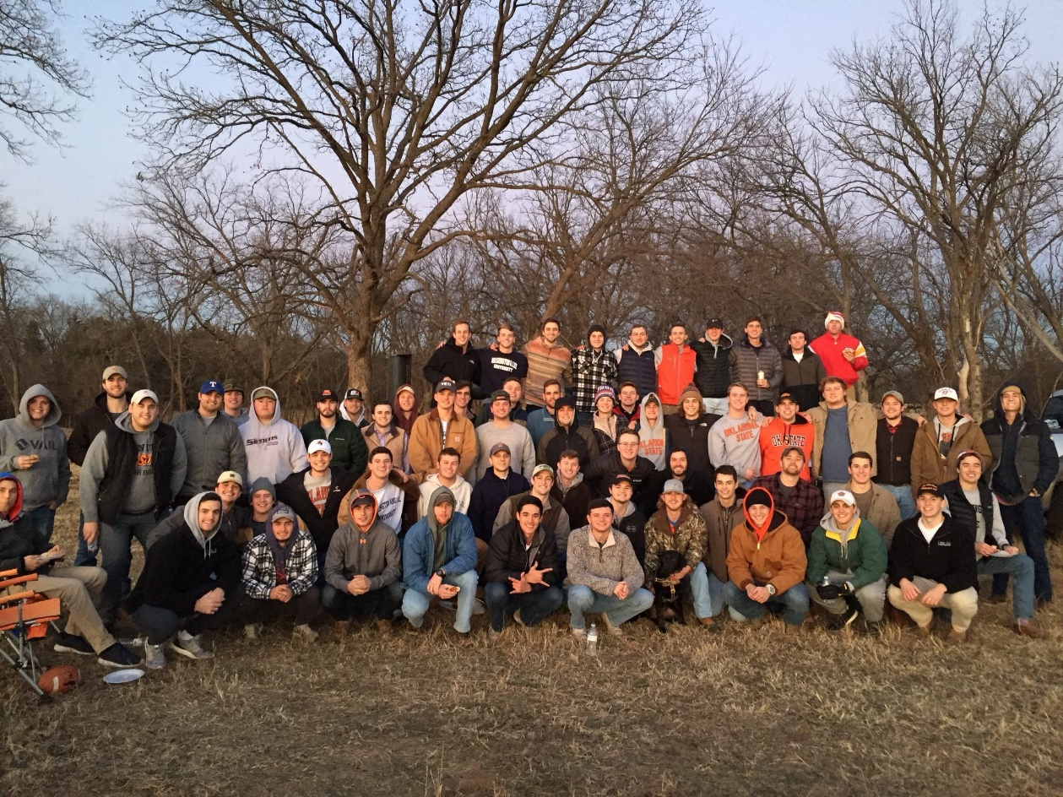
Help extend the Legacy
100% of active Members have made philanthropic pledges and/or contributions

Slide 32
Help extend the Legacy
Get Involved!
Invest through “stretch” personal and / or corporate philanthropic gift over 5 years
Become a Campaign ambassador/ challenge others to participate
Join collegiate brothers helping to fund this incredible opportunity and sustain our legacy

Slide 33
Help extend the Legacy
Donor Achievement Levels
Legion of Honor $1,000,000
Rock Chapter $500,000
White Star $250,000
Centennial $100,000
Knight $50,000
Donors reaching the above levels will be permanently recognized in our beautiful new facility

Slide 34
Help extend the Legacy
Get Involved!
Campaign Committee expects those making significant contributions to the CENTENNIAL CAMPAIGN will have tax deductible contributions under IRS rules.
See your tax advisor for details.

Slide 35
Help extend the Legacy
Get Involved!
For inquiries, gifts or pledge agreements, see a volunteer within
Campaign Committee
Tom Mason* Dee Paige*
Steve Brown Stan Bugh
Jed Dillingham Kent Dunbar
Joe Francis Neil Gilpin
Dave Hubble Kelly Miller
Griff Jones Luke Martin
Joe Strunk

Slide 36
Help extend the Legacy
Get Involved!
For contribution questions or gift-in-kind ideas, contact:
Neil Gilpin, Stewardship Chairman
918-749-0921
ngilpin@cgwpllc.com

Slide 37
One united vision
Love, Honor and Truth!

